Slide 1
Supply Chain Management Unit 8- Future of Supply chain
Venkadeshwaran K
Associate Professor
School of Mechanical Engineering
FET, JAIN (Deemed to be University)

Slide 2
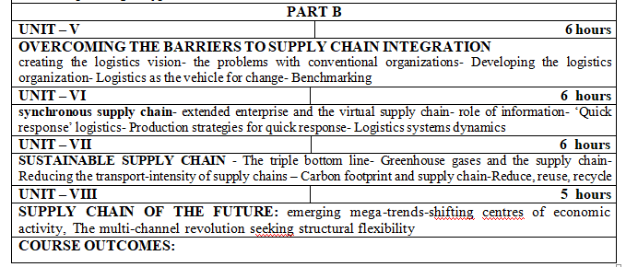
Syllabus

Slide 3
Contents – Supply Chain Megatrends Handbook
1
Introduction to the five Supply Chain Megatrends
2
Megatrend 1: Multiple Supply Chains
3
Megatrend 2: Move On or Move Home
4
Megatrend 3: Green and Sustainable Supply Chains
5
Megatrend 4: Global Supply Chain Risk Management
6
Megatrend 5: Managing Supply Chain Complexity
3

Slide 4
Emerging mega trend
major trend to globalised supply chains,
precursor for the ever more seismic changes
demographic and wealth redistribution changes include
existing supply chain arrangements less than optimal.

Slide 5
Shifting centres of gravity
All supply chains have a ‘centre of gravity’ determined by the pull of demand and supply factors.
shifting centres of gravity and the growing urbanisation of society are trends that are already evident
The rise of mega-cities presents a particular logistical challenge.
, there will be a need to bring supply much closer to demand.

Slide 6
The multi-channel revolution
Spurred on by the arrival of the Internet, there has been a dramatic growth in recent years of the use of alternative channels of distribution.
Internet is revolutionising both marketing and supply chain management.
the Internet ‘democratises’ the supply chain by placing the customer or consumer at the centre of the network.
Equally the supplier can learn more about the customers and their buying behaviour
Associated with the rapid rise of Internet channels has been the growth of ‘mobile’ media,

Slide 7
The multi-channel revolution
One of the advantages of having direct contact with the customer through online ordering is the dramatic improvement in visibility of real demand that it provides.
From a logistics and supply chain management perspective, the multi-channel revolution has a number of implications.
Whereas a bricks and mortar retailer has the ‘last 50 metres challenge’, the online retailer is concerned with the ‘last mile’ costs.

Slide 8
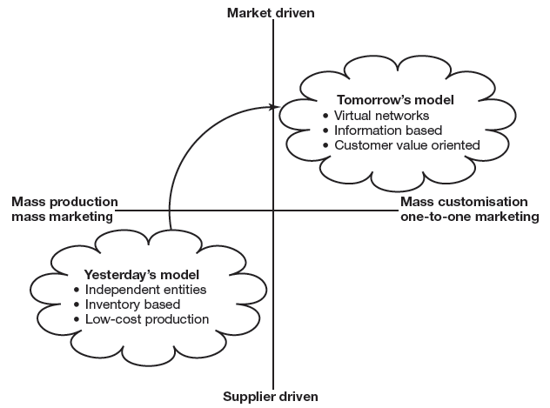
The need for adaptability
the rate of change has accelerated to the point where the business models that have served us well in the past may no longer work at all tomorrow.

Slide 9
Seeking structural flexibility
It has long been recognised that flexibility in operations and supply chain management is a desirable attribute. This capability might be defined as dynamic flexibility
This capability might be defined as dynamic flexibility

Slide 10
What are the key enablers of structural flexibility?
is a corporate culture and ‘mindset’ that is open to change and is comfortable with frequent changes to processes and working practices.

Slide 11
main elements that underpin structural flexibility include:
Visibility and information sharing
Access to capacity
Access to knowledge and talent
Inter-operability of processes and information systems
network orchestration

Slide 12
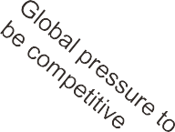



Leading companies work with various strategic levers to cope with the global supply chain challenges in order to stay competitive
Global challenges
Analysing the impact on
supply chains
Strategic levers used to improve the supply chain, mitigate global challenges and stay competitive
Cyber security
Managing the volatility of customer demand
Sustainability and CSR in supply chains Impact of oil prices on cost-to-serve
Supply chain principle in service organisations Vulnerability and risk management in supply chains
Resource security
Real collaboration in enterprise supply chains
Selection of talents to manage supply chains
Managing multiple organisational formats: agile, lean etc.
Cope with SC network, national, regional and global
Gartner Group
Aberdeen
McKinsey
Booz Allen
A.T. Kearney
...
Managing complexity in supply chains
Demographic challenges
Financial link to enterprise supply chains
Knowledge management in development of intelligent SC
Continuous improvement in supply chains
Source: World Economic Forum, Global Risks 2011
12

Slide 13
Implement Consulting Group has summarised the strategic levers into five supply chain megatrends
Multiple Supply Chains
Customer demand is developing to be more volatile and unpredictable than before. Market leaders are splitting their supply chains into dedicated value streams to meet different buying behaviours and to respond in time.
Move On or Move Home
As China has become the world’s primary country for manufacturing, the demand for labour has increased manifold. This has led to a steep rise in hourly wages. This trend is expected to continue, and other low-cost regions are becoming attractive.
Green and Sustainable Supply Chains
Socially and environmentally responsible managements have advanced the core of their companies’ value propositions. Especially in emerging economy contexts, corporate sustainability has emerged as a strategic priority for business leaders across industries.
Global Supply Chain Risk Management
Based on recent years’ natural disasters and disruptions in supply of goods combined with global supply chains and lower inventory levels, companies must now design their supply chains to mitigate risks to be able to supply the market even after upstream disruptions.
Managing Supply Chain Complexity
While operating a global supply chain network has a myriad of advantages, it has its challenges as well. One of these challenges is lack of visibility into various information sources leading to complexity which influences daily operations and performance.
13

Slide 14

Multiple Supply Chains
The root cause of the problems plaguing many supply chains is a mismatch between the type of product and the type of supply chain.
Marshall L. Fisher
5

Slide 15
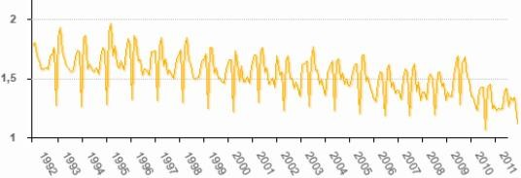
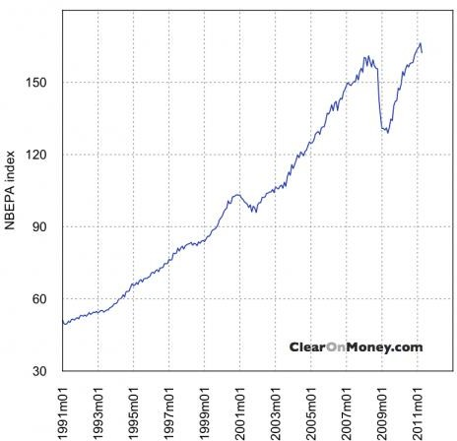
Unpredictable demand, lower stock levels and increased complexity drive multiple supply chains
Drivers and lead indicators
Unpredictable demand patterns caused by e.g. financial crises and environmental disasters
Pressure to lower stock and just-in-time deliveries at the same time as the world trade has increased
Total business inventories/sales ratios, 1992-2011
Source: www.census.gov/mtis
World trade development, 1991-2011
Source: The Netherlands Bureau for Economic Research
Impact on supply chains
As a consequence, companies are facing:
Increased complexity in supply chains
Decreased transparency throughout the supply chain
Risk of not being able to handle the complexity in the supply chain, damaging relationships throughout the supply chain
Difficulty in forecasting and planning production and inventory
To avoid the consequences, companies tend to:
Increase inventory levels creating higher inventory costs causing dead stock as demand is unpredictable
Create an organisation with many steps and non-value activities
15

Slide 16
Configuring multiple supply chains must be based on your customers’ demand
Impact on supply chain strategy
The below model divides supply chains into four dedicated conveyor belts based on different demand flow types. All supply chains demonstrate value-add and clear value propositions against the customers’ buying behaviour. For each flow type, the marketplace is analysed and used for configuration of related supply chains.
Flow types Types of supply chains
Impact on relationship
The below model describes the four generic configurations of the supply chain in relation to ”relationship to customer” vs. ”predictable demand”.
Collaboration and forecasting
Innovative and creative solutions
Tight
”FULLY FLEXIBLE”
”AGILE”
Cavitation
”Fully flexible”. Unplanned and unplannable demand due to unknown customers with exceptional, sometimes emergency, requests
”CONTINUOUS REPLENISH- MENT’
”Agile”. Usually unplanned, at least until the last possible moment. May result from promotions, new product launches, fashion marketing, unplanned stock-outs or unforeseen opportunities
Relation- ship to customer
Surge
”Lean”. Regular pattern of demand, quite predictable and forecastable, although it may be seasonal. Tends to be mature low-risk products/services
”LEAN”
Semi- wave
Loose
”Continuous replenishment”. Very predictable demand from known customers. Easily managed through tight collaboration with collaborative customers
High
Low
Balance service and costs
Base
Request for low cost and high reliability
Source: Gattorna
Predictable demand
Source: Gattorna
16

Slide 17
Move On or Move Home
Life is like riding a bicycle – in order to keep your balance, you must keep moving.
Albert Einstein
8

Slide 18
Move On or Move Home – companies move further out for lower costs
Drivers and lead indicators
A shortage of skilled labour supply has led to rapid cost inflation – more than 20% year-on-year in some pockets. This trend is expected to continue.
Comparative wage inflation in LCC Asia – $/hr (2008-2015)
Vietnam Thailand Indonesia India China
3.,5
3.,0
2.,5
2.,0
1.,5
1.,0
0.,5
0.,0
2008 2009 2010 2011 2012 2013 2014 2015
Source: BCG Analysis 2011
Impact on supply chains
Companies are considering how to move their facilities and which products or categories where it makes sense:
Transparency of the supply chain
Sustainability
Delivery reliability
Time-to-market
Culture
Trends are emerging where companies are considering total landed cost, consisting of:
Supply chain downtime costs
Logistics costs
Duties and taxes
Future inflation
Infrastructure and capacity
Efficiency
Products and product lines are being designed for modularisation so that they can be moved over time and adjusted to the supply chain strategy
Indoneisa

Slide 19
Move On or Move Home – companies move further out for lower costs
Supporting data
Currently, there are still companies that prefer to stay within low- cost countries as the cost of shifting manufacturing and supply chain is too high.
Plans of relocating within or expanding outside China
(% of respondents)
A few years ago (%) Today (%)
Impact on supply chain structure
Cost impact:
Material costs
Labour costs
Transport logistics
Customs duties
Salary costs
Other fixed costs
Within China
No
plans
Within and outside China
Within China
17
28
Sensitive risks perspectives
3
7
Out of
China
50
One-off costs:
Restructuring costs
Transition costs
Investments
Inventory
Incomes
Within 14 _{and}
8 outside
73
No plans
Out of China
China
Source: AmCham Shanghai Survey,
Increasingly, companies are paying close attention to the landed cost – comprising freight, currency and inflationary costs
In 2015, Mexico is expected to be 15% cheaper than China
compared to being 20-30% more expensive today
Source: BCG and Alix Partners

Slide 20
Green and Sustainable Supply Chains
Mother nature does not do bailouts.
Al Gore
11

Slide 21
Green and Sustainable Supply Chains – doing well by doing good
Drivers and lead indicators
Many western companies seek to benefit from the cost advantages offered in emerging economies in Eastern Europe, Asia and Latin America
As the cost advantages offered in emerging economies often come along with social and environmental standards below those of western countries, companies face the question of what impact a social and environmental engagement beyond these standards has on their capabilities
Sustainability as a purchasing goal (% of respondents) ”Is sustainability one of your company’s strategic purchasing goals?”
2003 21%
Impact on supply chains
Sustainability will impact supply chains and companies’ internal operations differently, but the following are seen as the main changers:
Closer relationships between the tiers throughout the supply chain to gain transparency of operations
Use code of conduct towards suppliers to prevent cases that can have a negative impact on the business and, thus, as a risk management tool
Supply chains are becoming increasingly complex as there are many parameters companies need to be in control of
Slower supply chains as transportation will slow in order to reduce emissions in the supply chain. This will require
re-thinking of the companies’ supply chain strategy and set-up. In contrast, supply chains move closer to markets and become more expensive
Product development will increasingly focus on the ability to re-use scrapped products
Reverse logistics are becoming a new supply chain
Sustainability is used as a supply chain strategy to gain customers
2009
56%
2011
69%
Source: Roland Berger, 2011

Slide 22

Compliance with society calls for sustainable supply chains
Supply chain compliance with society
Society demands companies to be pioneers setting new norms for responsible behaviour, and companies comply to reduce the risk of not being the customers’ choice
Future norms
Accepted norms
Industrial standards
Laws and legislation
Source: Implement Consulting Group
Impact on supply chain transparency
Companies are demanded to be proactive, have high standards and be best in class in their value and supply chain within:
Environmental responsibility:
Use of resource-efficient production technologies
Highly effective filtering systems to reduce emissions
High standards regarding use of environment-friendly and energy-efficient input factors
Environment-friendly product development through new technologies focusing on the product life cycle, including re- usage of scrapped products
Social responsibility:
Compliance with human rights
Ensure no use of forced labour, child labour and the right to
collective bargaining
Supportive working conditions, attractive staff benefits as well as development programmes
Stringent monitoring of workplace safety and comprehensive safety training
Active contribution to local communities, especially with regard to improvement of living conditions (e.g. water supply and educational infrastructure)

Slide 23
Global Supply Chain Risk Management
There are risks and costs to action. But they are far less than the long-range risks of comfortable inaction.
John F. Kennedy
14

Slide 24
Global Supply Chain Risk Management – building a robust supply chain and preparing for disaster
Drivers and lead indicators
Just-in-time production
Lean inventory
Natural endowment and specialisation among few suppliers
Sourcing from destinations where governments have major control of resources
Impact on supply chains
Mitigation of risks is manifold and, hence, impacts companies and their supply chains in multiple ways:
Supply chain design:
Multiple sourcing of key components and service
Geographically spread supply chains to serve customers
Increased transportation costs as a consequence of multiple sourcing and geographically spread supply chains
Longer ramp-up periods to serve the customer leading to higher stocks to prevent production downtime and secure ability to deliver to customers
Risk of lower quality as an effect of sourcing from a non-qualified supplier to secure supply to customer
Total factors affecting supply chain: Business Continuity Survey, 2011
Product-related:
Product development without the usage/consumption of critical resources and products that disturb the supply chain
Vertical integration of supply chain to secure IPRs
50%
40%
20%
20%
15%
12%
Adverse IT Transport weather outage network
disruption
Earth- quake or tsunami
Supplier Loss of failure skills
Source: Business Continuity Institute

Slide 25
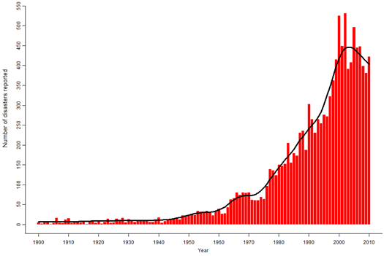
Disasters affect supply – therefore, risk management to secure supply becomes a strategic parameter
Natural disasters reported from 1900 to 2010
Recent events that have adversely affected supply chains:
Japanese earthquake and nuclear accident
Financial crises and economic uncertainty
Ash clouds
Floods in Australia and Southeast Asia
The above figure includes all disasters from 1900 to 2010 which meet at least one of the following criteria: 10 or more people killed, 100 or more people affected, a declaration of a state of emergency by country authorities or an appeal for international assistance by country authorities.
Source: EM-DAT
Impact on supply chain strategy
Companies are now working more strategically with risk management and how to prevent downtime in part of the supply chain
In a survey conducted by Roland Berger, more than 500 CEOs, COOs and purchasing managers were interviewed to understand purchasing trends in 2011
% of respondents confirming the attributes in their organisation for SCM
2003 2009
2011
82%
77%
54%
77%
74%
43%
51%
49%
35%
Importance of risk Support of senior Regarded similar to management management finance, sales

Slide 26
Managing Supply Chain Complexity
Any intelligent fool can make things bigger and more complex... It takes a touch of genius – and a lot of courage – to move in the opposite direction.
Albert Einstein
17

Slide 27
Managing Supply Chain Complexity – more countries, more customers… more complexity
Drivers and lead indicators
Increase in customers or customer locations
Impact on supply chains
The design of supply chains needs a re-think, starting at the marketplace in order to link customers and suppliers closer to your own business
Sourcing and distribution will become highly complex to deliver efficiency
Production planning will become more difficult
Inventories need to be reduced to reduce costs, but this is challenged by more difficult production planning that will require higher inventories to avoid production stops
Flexibility is required to cope with demand peaks
Products need to be customised with regional preferences and assembled as per customer order
79%
Increase in products/ variances offered
67%
High fluctuations in customer orders
65%
Increase in strategic suppliers
51%
Increase in manufacturing facilities
47%
Increase in distribution facilities/inventory locations
44%
Source: Survey by PwC and PRTM
% of companies responding in the affirmative to the factors driving supply chain complexity in a survey conducted by PwC and PRTM of more than 350 companies across the globe and industries

Slide 28
Reduce complexity by rational business behaviour
+3-5
percentage points
Levers to reduce complexity
Optimise production and logistics | Shut down locations
 | Enhance utilisation
 | Avoid investments
Cut material costs | Increase economies of scale
 | Reduce suppliers, raw materials
 | Introduce technology platforms
Adjust service capacities | Adjust sales and R&D personnel
 | Optimise size of orders
 | Reduce unprofitable customers
Increase margins | Improve the product mix
 | Raise prices
 | Eliminate unprofitable products without any replacement
Addi- tional EBIT
reserves
Old EBIT
New EBIT
Source: A.T. Kearney

Slide 29

Contacting Implement Consulting Group
Learn more about how we work with Supply Chain Management
Go to Implement Consulting Group's main website
Implement Consulting Group P/S
Lars S. Feldstedt, Partner Email: lsf@implement.dk Mobile:+45 2338 0068
Thomas G. Holm, Partner Email: tho@implement.dk Mobile:+45 5138 7427
Jan Lythcke-Jørgensen, Partner
Email: jlj@implement.dk Mobile: +45 2338 0017

